Slide 1
Adding to Pacman example
A Scratch Lesson

Slide 2


Steps
Open pacman example and try it out
Figure out how it works
Take a copy of pacman
Add some stuff for pacman to eat
Add a score
Add a GHOST
Aaaarrgggghhh – GAME OVER
Add an escape route

Slide 3
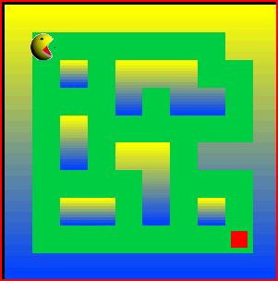
Open pacman example and try it out

Slide 4
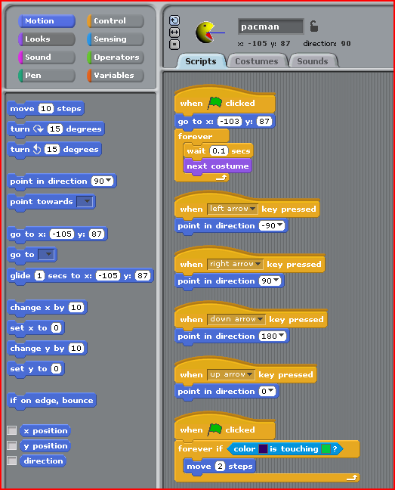
Figure out how it works

Slide 5
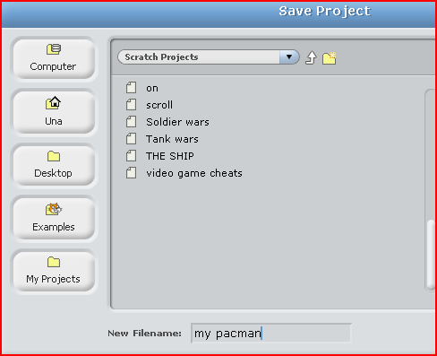
Take a copy of pacman

Slide 6
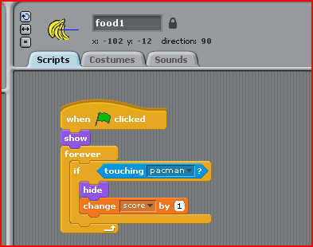
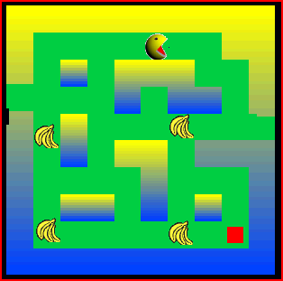
Add some stuff for pacman to eat

Slide 7
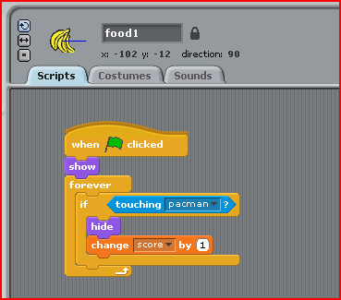
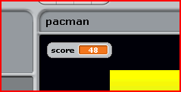
Add a score

Slide 8
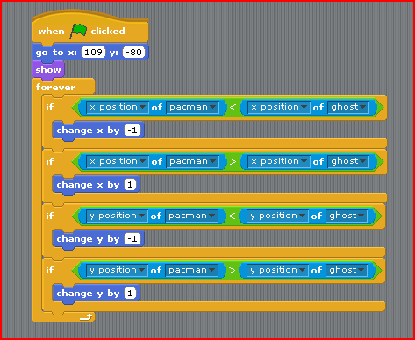
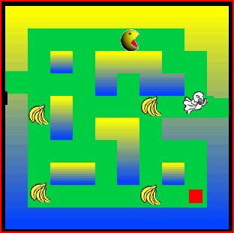
Add a GHOST – chases pacman

Slide 9
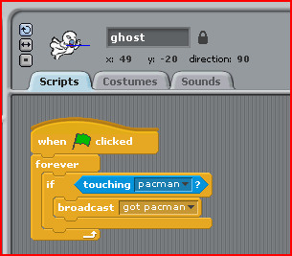
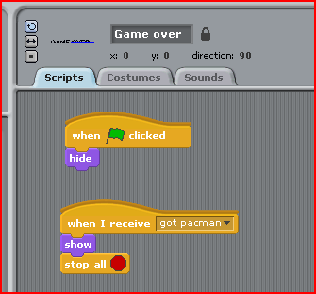
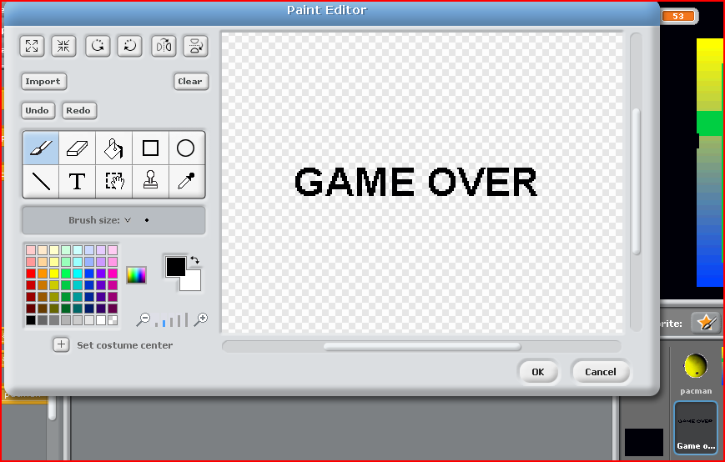
Aaaarrgggghhh – GAME OVER

Slide 10
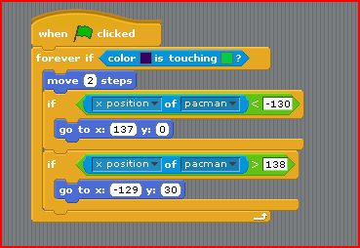
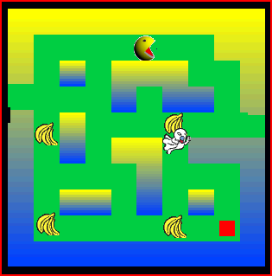
Add an escape route

